Slide 1

MLA Training Project
Programming Language Detection
Adham Wael - Nour El-din Hazem - Amr Mohamad

Slide 2
Content
Dataset
01
Splitting Data
02
Tokenizer
03
Data Tokenization
04
Transformer
05
Removing Comments
06
Different Approaches and Results
07

Slide 3
Dataset
300k files from GitHub.
We used 2 different approaches.
1st approach -> 30 programming Languages (10K files each) with total 300K files from GitHub.
2nd approach -> 10 programming Languages (30k files each) with total 300K files from GitHub.

Slide 4
Splitting Data
We split data to train, validation and test .
70% for train.
10% for validation.
20% for test.

Slide 5
Tokenizer
Building Vocabulary and Merge Rules:
The vocabulary was built by training the Byte Level Byte-Pair Encoding Tokenizer (Byte Level BPE Tokenizer).
Vocabulary Size: 50K.
Min Frequency : 2
Note : Vocabulary was built from the training dataset only.

Slide 6
Data Tokenization
Tokenization was done using the built vocabulary and the same Byte-Level BPE Tokenizer.
Maximum Size : 512 tokens.
Padding is done to files were number of tokens is less than 512.
Tokenization was done to the whole dataset .

Slide 7
Transformer
CodeBERTa is the used transformer.
A RoBERTa-like transformer trained on CodeSearchNet Dataset from GitHub.
Supports only 6 programming languages.
CodeBERTa-Language-id: a Version of CodeBERTa finetuned on the task of programming language identification.
We used it to fine-tune on 30 and 10 programming languages.

Slide 8
Removing Comments
We build a dictionary having all the comment identifier of the 30 Languages.
Some Languages have Special comment format so we made a special function for them. ( ex: shell, Fortran).
Some files became empty files after removing comments (as they were all comments) .So, we removed them.
After removing empty files the data was unbalanced. So, we balanced them by making all files equal to the min. programming languages having files.
Note : Splitting Data was done after removing comments

Slide 9
Different Approaches And Results
Using 30 programming Languages:
1st approach -> leaving comments.
2nd approach -> removing all comments.
Note : Training Final Layer only of the Transformer. (613662 trainable parameters)

Slide 10
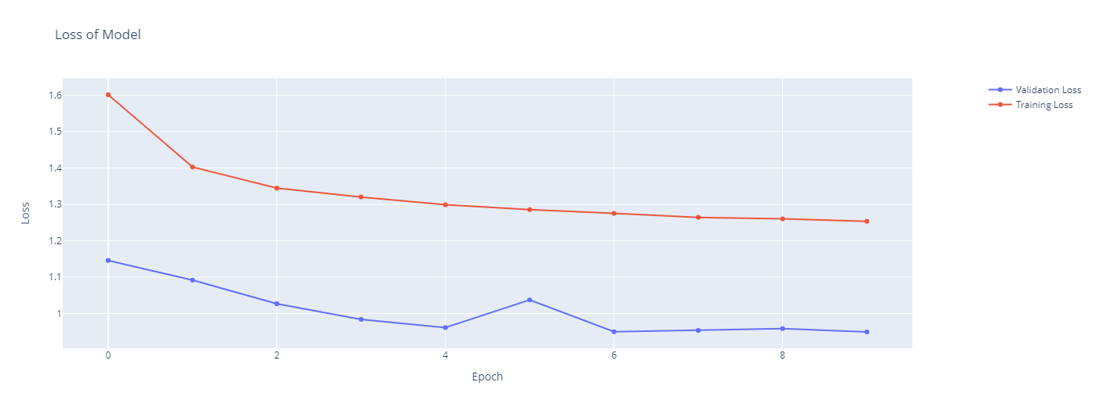
Different Approaches And Results
Leaving comments:
10 epochs was done (1:15 hour each)
Loss plot

Slide 11
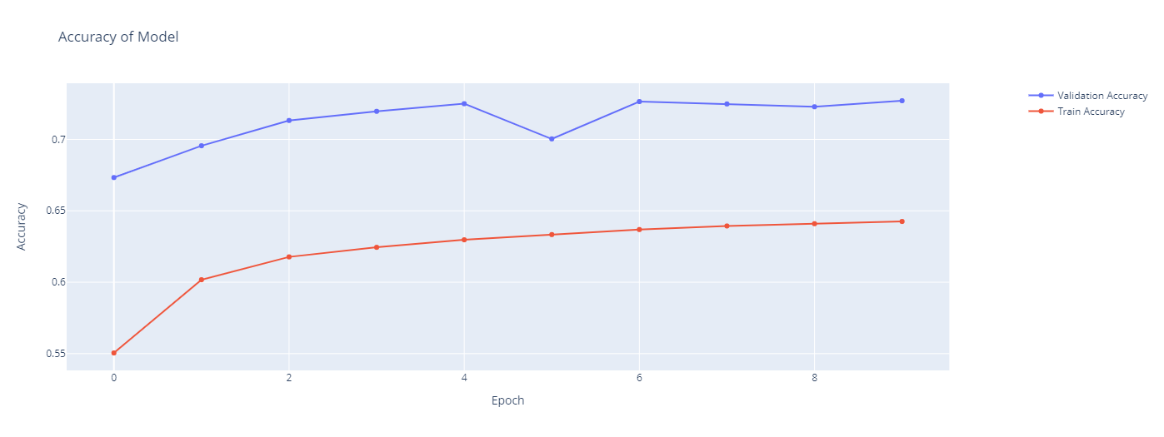
Different Approaches And Results
Leaving comments:
Accuracy Plot

Slide 12
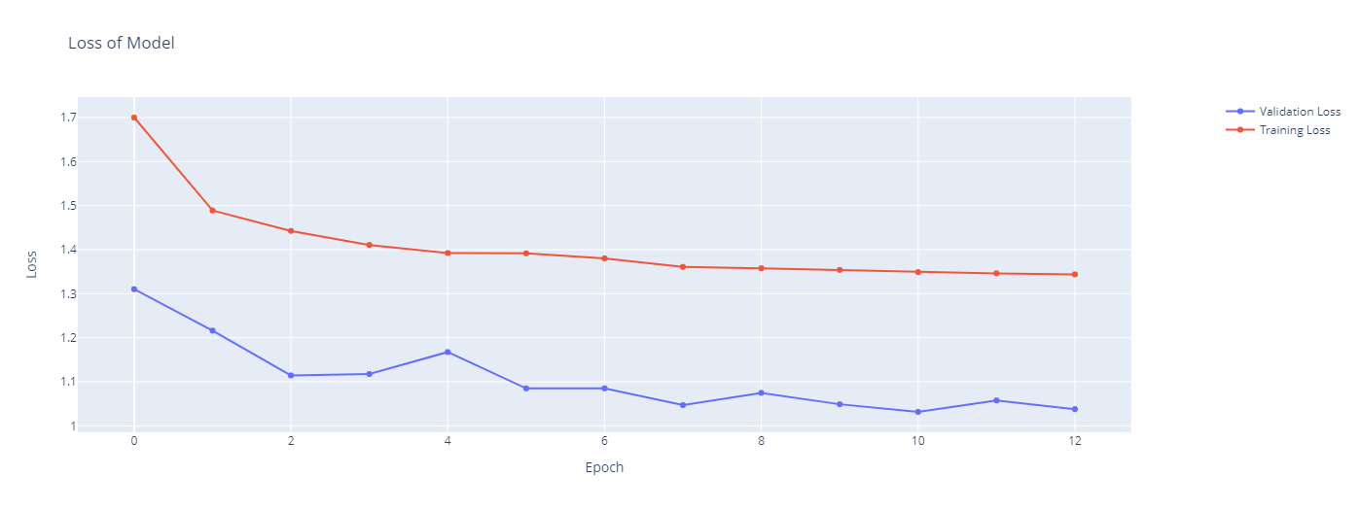
Different Approaches And Results
Removing comments:
13 epochs was done (1:15 hour each)
Loss plot

Slide 13
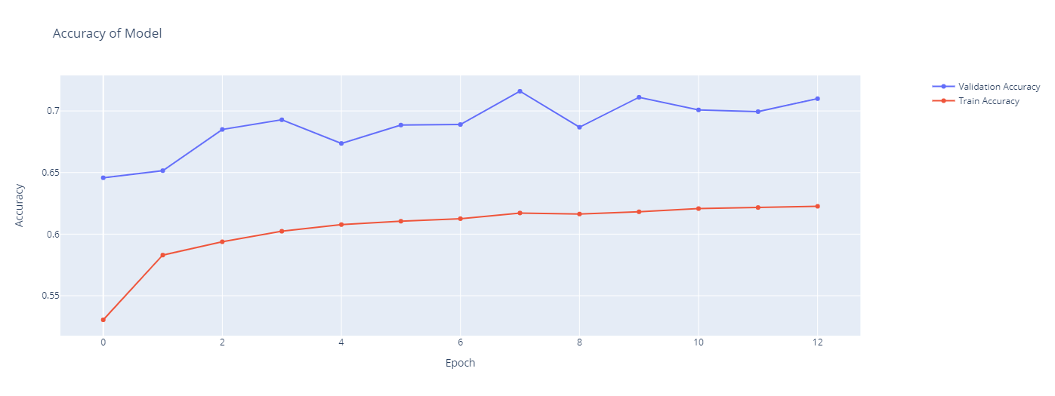
Different Approaches And Results
Removing comments:
Accuracy Plot

Slide 14
Different Approaches And Results
Results using 30 Languages
 | With Comments | Without Comments
Train Accuracy | 64.25% | 62.25%
Validation Accuracy | 72.71% | 70.99%
Test Accuracy | 72.95% | 70.7%

Slide 15
Different Approaches And Results
Using 10 programming Languages:
1st approach -> Removing all Comments (train the final layer only).
2nd approach -> Removing all Comments (train the whole transformer).
Note : Final layer have 598282 trainable parameters but whole transformer have 83458570 trainable parameters.

Slide 16
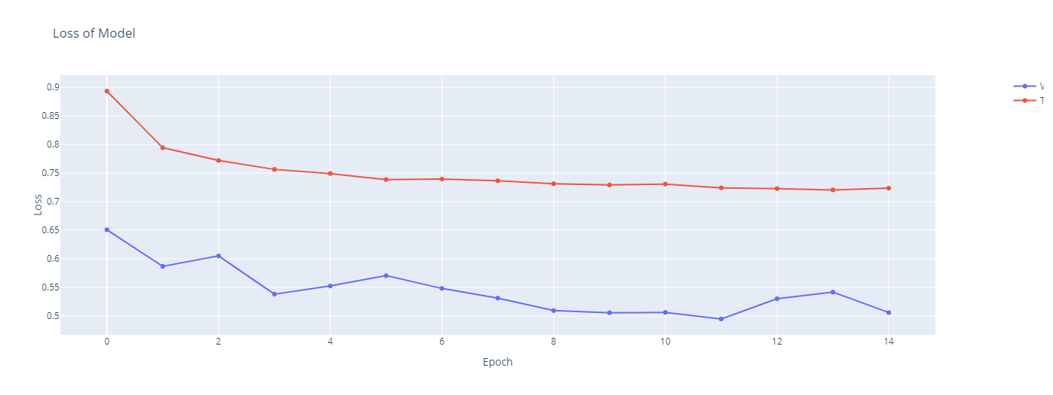
Different Approaches And Results
Removing all Comments (train the final layer only):
15 epochs was done (1:15 hour each)
Loss plot

Slide 17
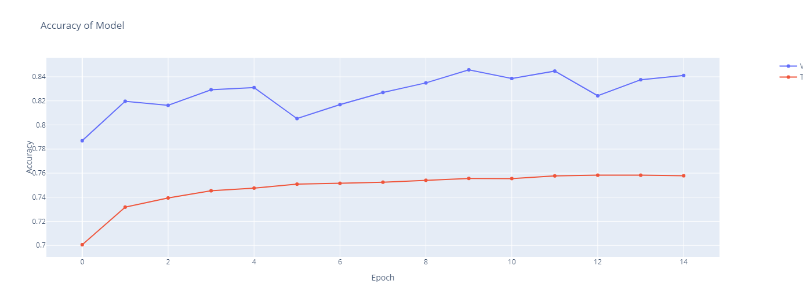
Different Approaches And Results
Removing all Comments (train the final layer only):
Accuracy Plot

Slide 18
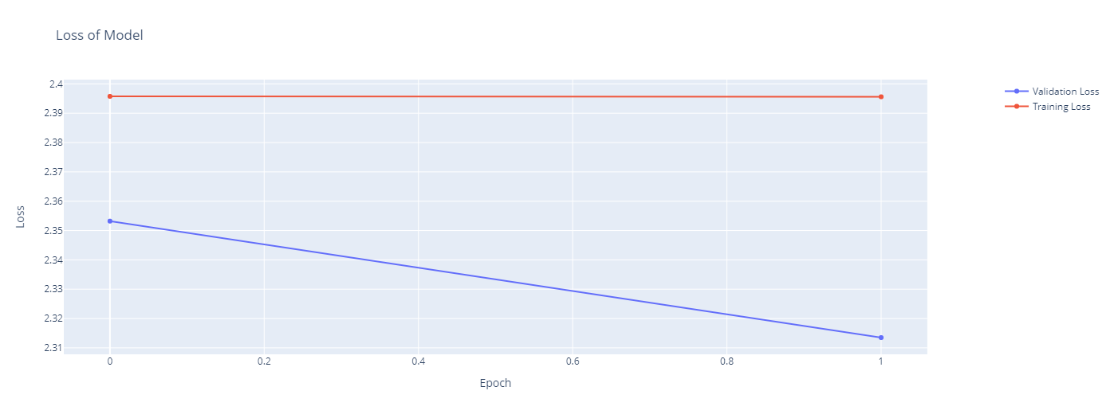
Different Approaches And Results
Removing all Comments (train the whole transformer):
2 epochs was done (3 hours each)
Loss plot

Slide 19
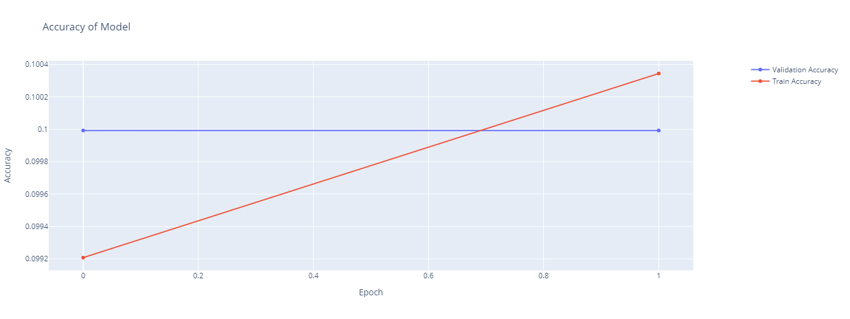
Different Approaches And Results
Removing all Comments (train the whole transformer):
Accuracy Plot

Slide 20
Different Approaches And Results
Results using 10 Languages
 | Final layer | Whole transformer
Train Accuracy | 75.7% | 10.01%
Validation Accuracy | 84.1% | 9.99%
Test Accuracy | 83.6% | 6%

